Slide 1


Disiplin Ilmu IT
Disusun oleh
Tim Rasyid Institute

Slide 2
Disiplin Ilmu IT
Software Engineering
(SE)
Information Technology
(IT)
Information System
(IS)
Computer Engineering
(CE)
Computer Science
(CS)

Slide 3
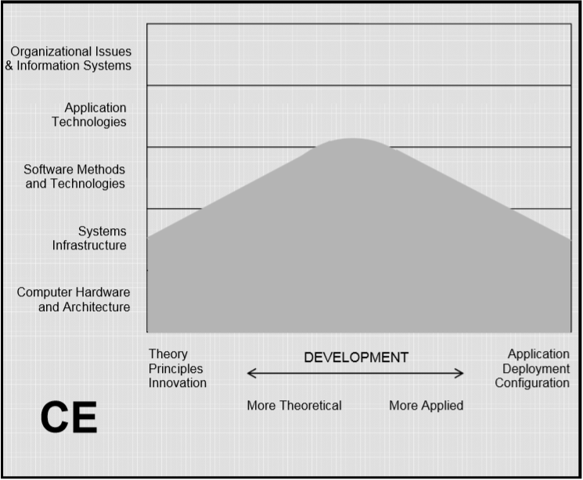
Digital System Design
Network
Operating Systems
Cyber Security
Grid Computation
Network Management
Internetworking
Internet of Things (IoT)
Computer Engineering
(CE)

Slide 4
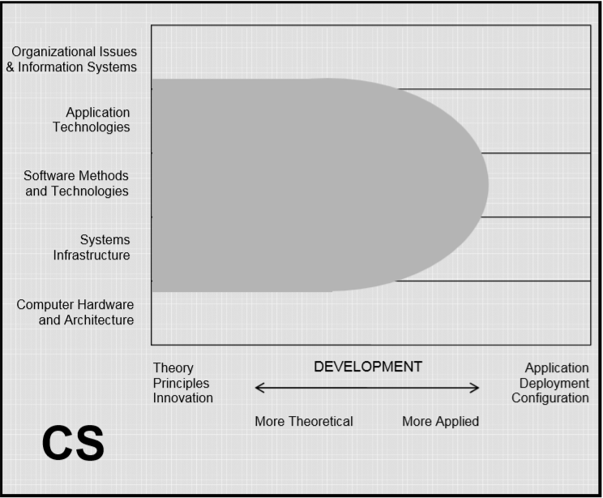
Computational Thinking
Basic Algorithm
Algorithm Design
Discrete Math
Numeric Comp.
Statistics
Computer Vision
Artificial Intelligence
Machine Learning
Big Data
Computer Science
(CS)

Slide 5
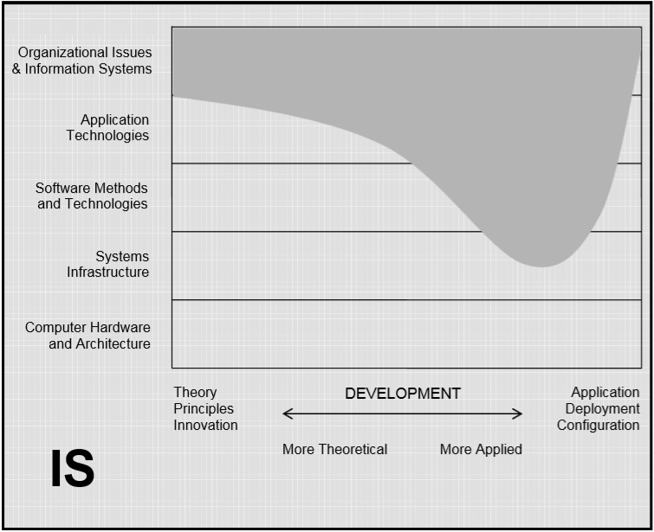
Project Management
Customer Relationship Management
UML Diagram
Software Development Life Cycle
Software Development Antipatterns
Information System
(IS)
Computer Science
(CS)

Slide 6
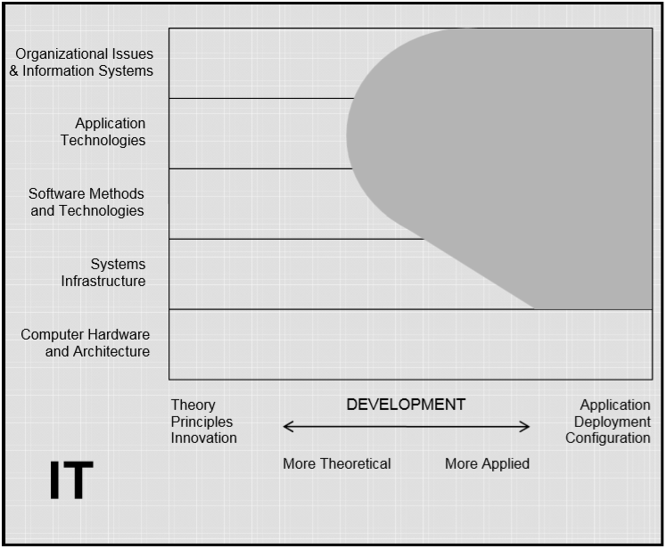
Software Testing
Computing Infrastructure
Content Management System (CMS)
Internet & Web Technology
Information Technology
(IT)

Slide 7
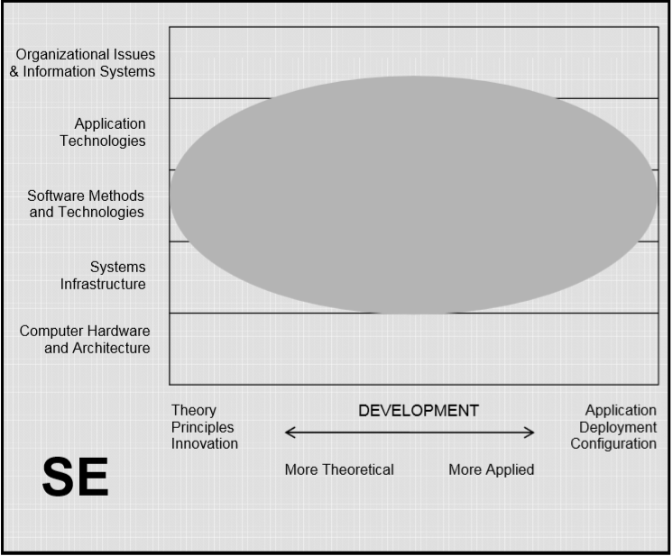
Object Oriented Programming (OOP)
Software Design & Architecture
Clean Code
Design Patterns
User Interface
Database Management System (DBMS)
Software Architecture Antipatterns
Software Engineering
(SE)

Slide 8
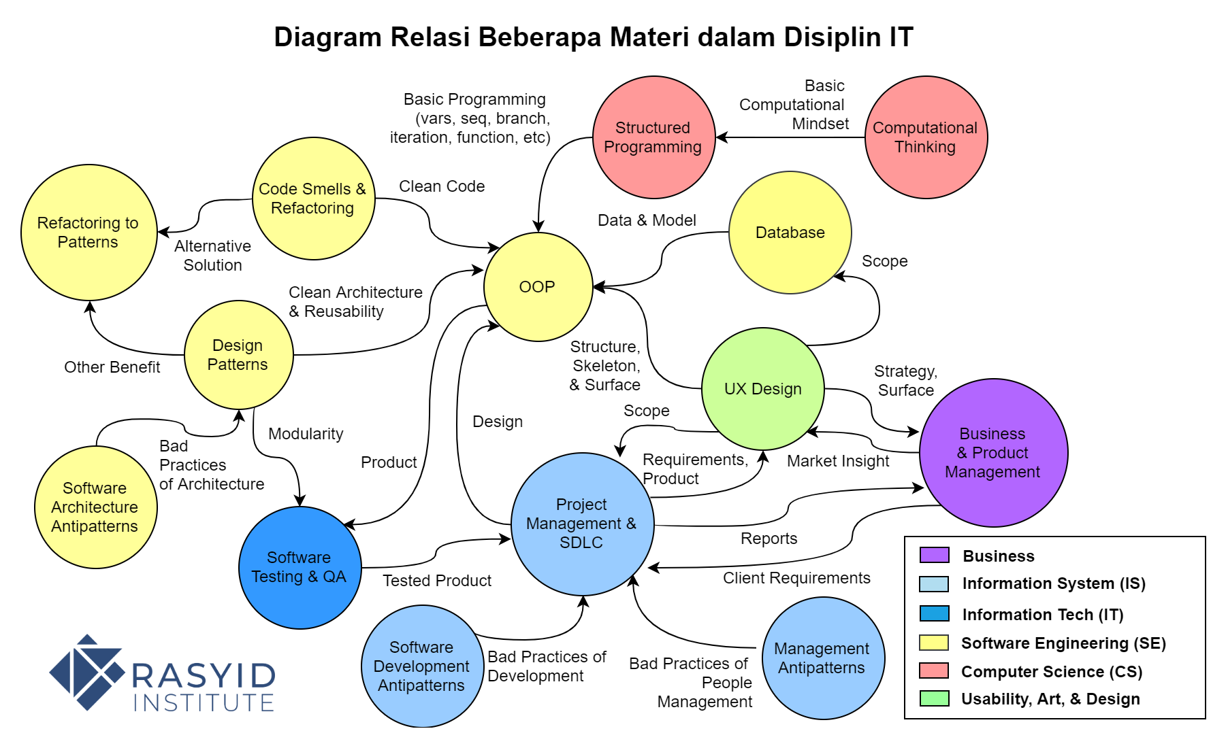

Slide 9
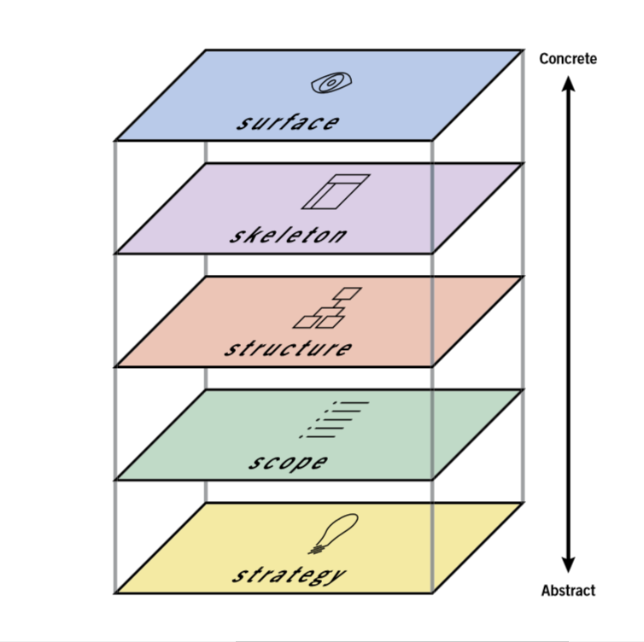
Product / Prototype
View Class Diagram
Business Process Class Diagram
Use Case Diagram, Conceptual Data Model (CDM), & Model Class Diagram
Business (Market Analysis) Document

Slide 10
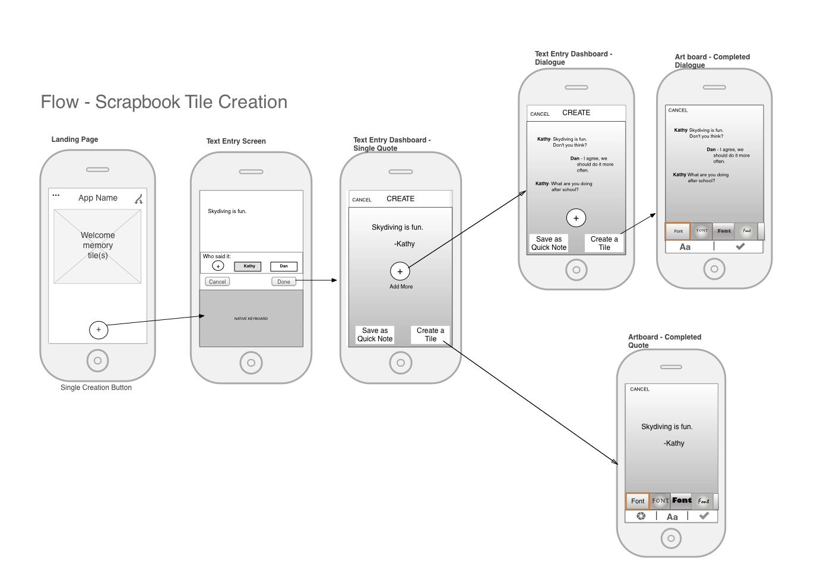
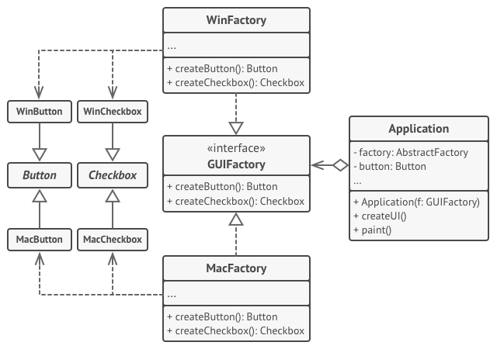
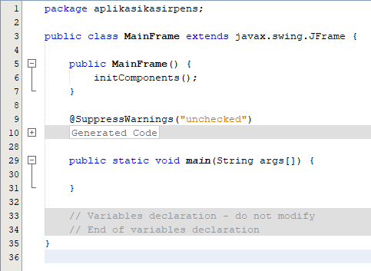
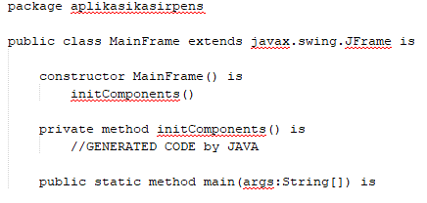
Wireflow
Class
Diagram
Source Code
Pseudocode

Slide 11
Source Code vs Pseudocode vs Class Diagram
Aspek Pembeda | Source Code | Pseudocode | Class Diagram
Sifat | Konkrit | Semi-Konkrit | Abstrak
Mampu Membedakan Agregasi vs Komposisi | Tidak | Tidak | Ya
Digunakan oleh | Programmer | Programmer GrayBox Tester WhiteBox Tester | System Analyst

Slide 12
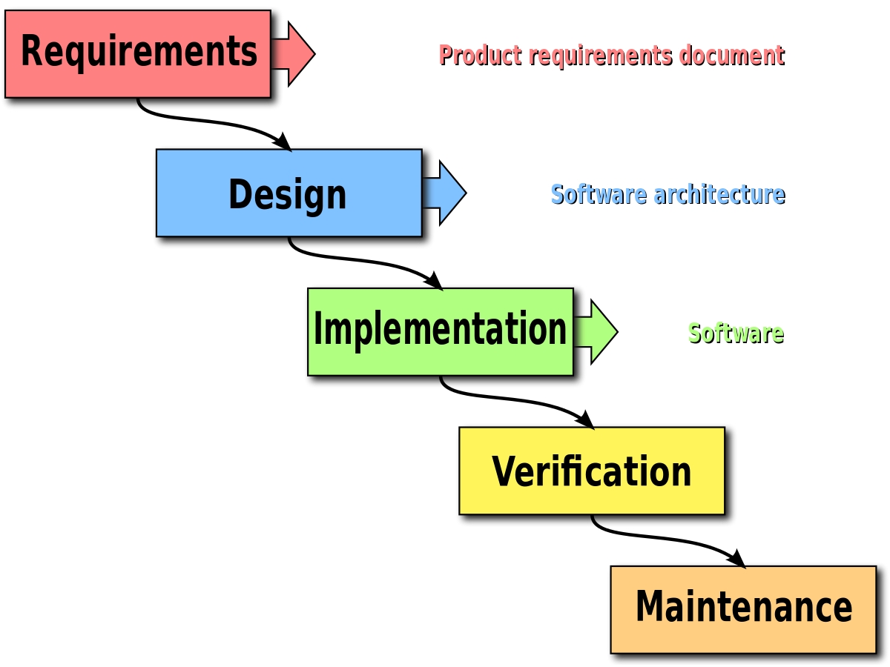
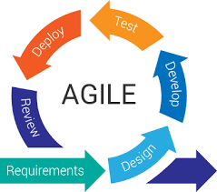
Waterfall vs Agile

Slide 13
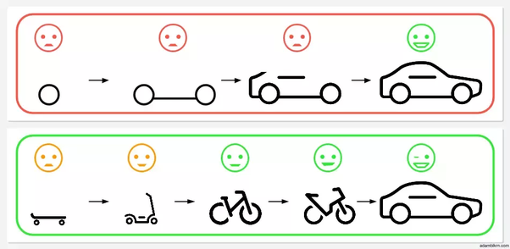
Traditional vs Agile = Incremental vs Iterative
Incremental
Iterative

Slide 14
Wireflow
Class
Diagram
Source Code
Pseudocode

Slide 15
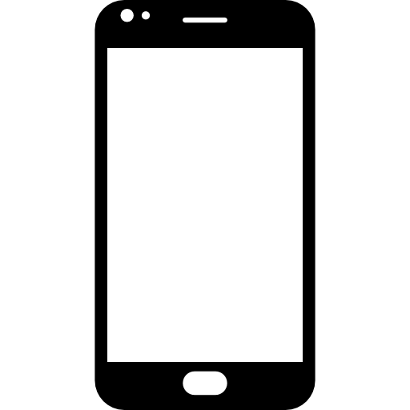





Slide 16



Slide 17
TULISKAN 30-40 Teknologi terkini yang digunakan (Dapat Berupa Bahasa, Framework, IDE, Library, Engine, Database, Dll)

Slide 18
